Slide 1


p5 - A JavaScript Library
A library for - artists, designers, educators, and beginners && some people inspired to learn programming from Mr. Daniel Shiffman.
Presentation By – Malav Patel

Slide 2
What is P5.js
Originally Processing is a flexible software sketchbook and a language
for learning how to code within the context of the visual arts.
P5.js was idea to implement the processing in modern language environment.
The Idea was proposed to make implement processing in JavaScript
Therefore the Library P5 was created as a interpretation of processing to JavaScript,
but it evolved in to further more than just the simple interpretation of processing
Due to people from all over the world contributing to development & became its own different development environment.

Slide 3
Using the original metaphor of a software sketchbook.
p5.js has a full set of drawing functionality.
However, we not limited to your drawing canvas.
We can think of your whole browser page as your sketch!
For this, p5.js has add-on libraries that make it easy to interact with
HTML5 objects
including text
input,
Video
webcam and sound.

Slide 4
P5.js Basic Setup
Add P5.js library into you project by
Downloading and adding <script src=“Your/Path/to/p5.min.js”></script>
Or from CDN src=https://cdnjs.cloudflare.com/ajax/libs/p5.js/0.8.0/p5.min.js
Now add “Sketch.js” ← Default Naming Convention, to the index.html
Further inside the Sketch.js we have 2 Main Functions.
function setup()
function draw()
The life cycle lies in these two functions.
There are more Life Cycle Function available but we don’t always use them.

Slide 5
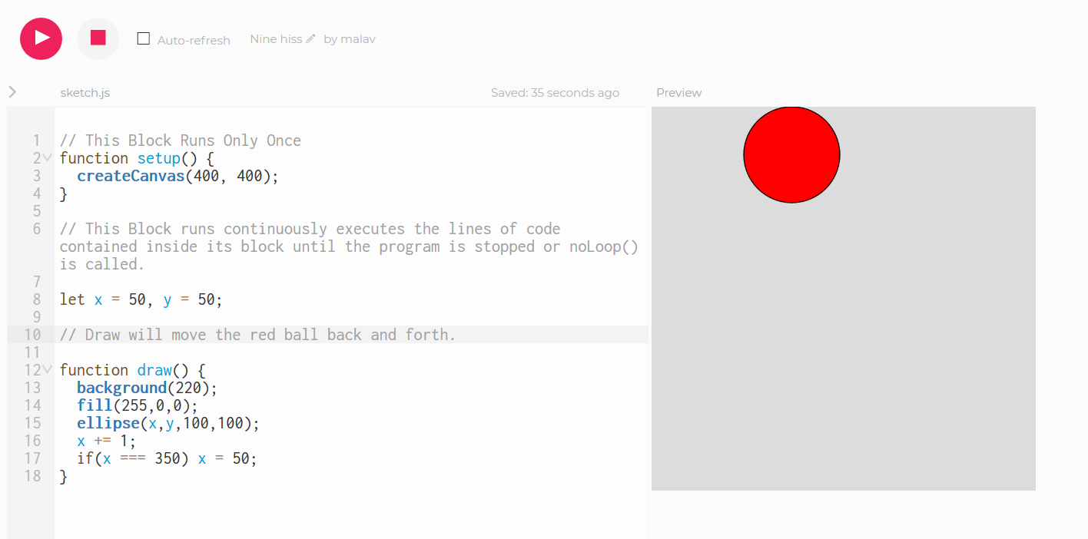
setup() && draw()

Slide 6
More Features
3D – Make the Content of the browser 3D what is more to Say.
Math – are you bad at mathematics and forget how to calculate angles, and distance and Sine wave, Cos wave etc… everything is covered in short abstractive methods for us to use.
We got all the physics covered – want to make cloth simulation, Spring, Smoke Particles, Flocking, Brownian Motion, and Tons of more & all abstracted methods to implement.
We got tons of shapes Umm all of the shapes I say.
Want to use API to get data we got that covered.

Slide 7
Features Continue.
DOM that’s Basic.
Mobile – Ayy That is also included.
Inputs – Mic, Camera, Keyboard, Touch inputs, All of them.
Sound and Typography too.
Geoloaction
Arduino
Game library – And More

Slide 8
Abstraction
The Main Feature of P5.js is abstraction so that we only have to deal with the problem of the creative idea we have
And Skip the Most of the hard part that is dealing with Math, Functions calls And Other stuff.
p5.js provides simple and effective methods and their lifecycle easily understood by anyone even beginners.
Eg. We have method keyPressed() as simple it sounds, anyone can interpret that the code in block will be activated every time key is pressed.
We can check with key codes and see which key is pressed to further filter it.
Function preload() will load everything in it before the execution.

Slide 9
Wiki – Filler Silde (I don’t know what’s more)
Started by Lauren McCarthy in 2013
A native JavaScript alternative to Processing.js that has the official support of the Processing Foundation.
Github Starts – 10,000+
Forks- 1,500+
Works with all Browser’s.
More that 1000 contributors.
Introduction – https://hello.p5js.org
Ahhhhhh Nothing I can think of.

Slide 10

Thank You – Malav Patel

